Slide 1
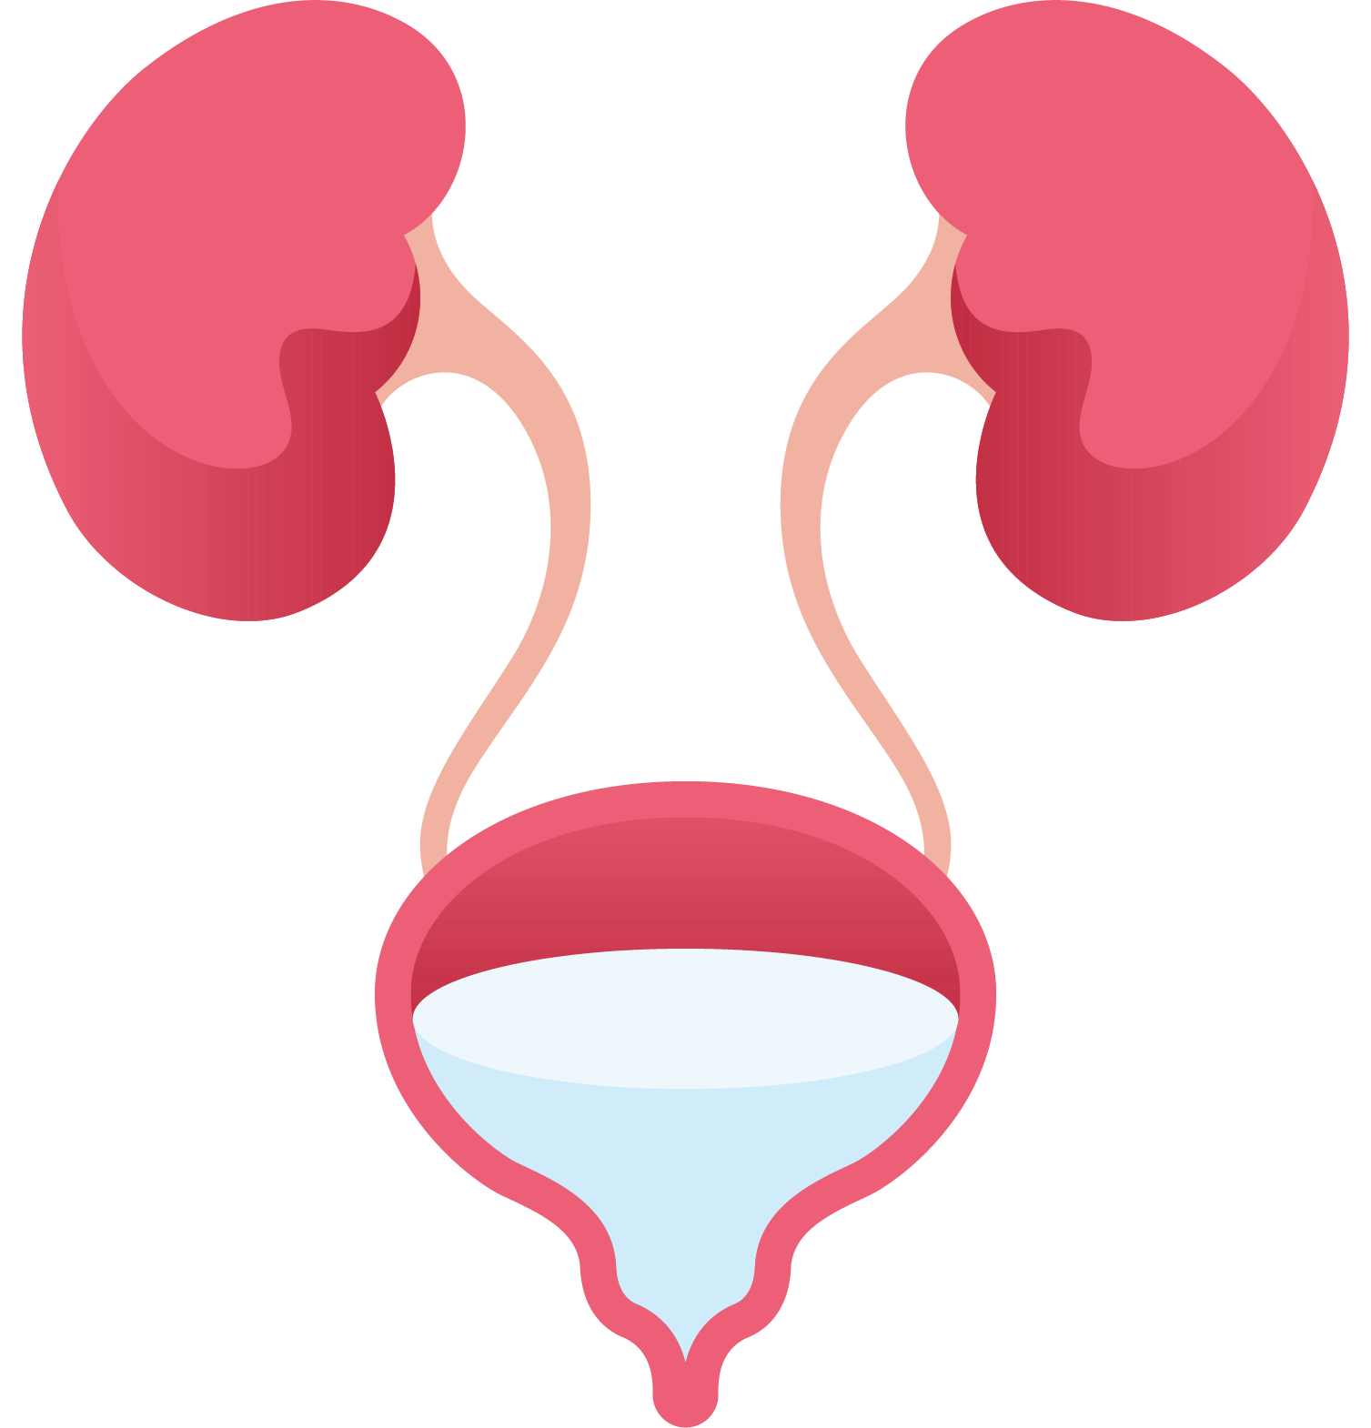



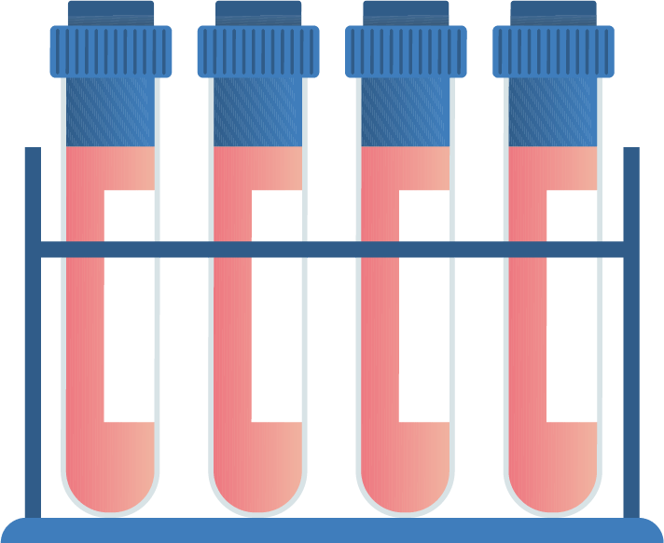
Neural Networks in Disease Prediction
Team 27:
Sabrina Chen
Demir Degirmenci
Lizzie Wang
Parin Vora

Slide 2
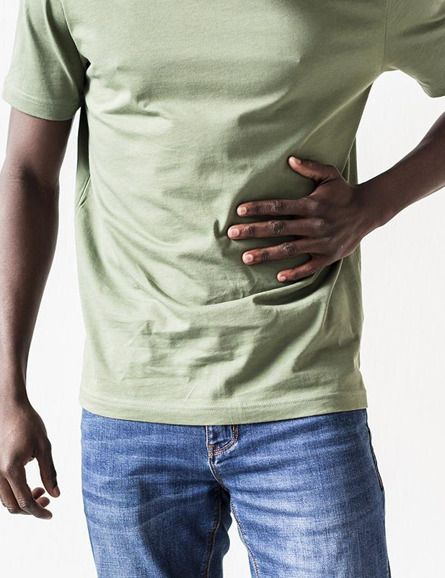

01
Motivation

Slide 3

Motivation: Enhancing Medical Diagnostics with AI
Problem:
Misdiagnosis leads to severe complications, including incorrect treatments and increased patient risks.
Goal:
Develop a deep learning model to predict diseases based on symptoms, supporting doctors in accurate and efficient diagnoses.
Impact
Streamlines medical workflows, reduces risks, and supports online and in-hospital assessments for better patient outcomes.

Slide 4
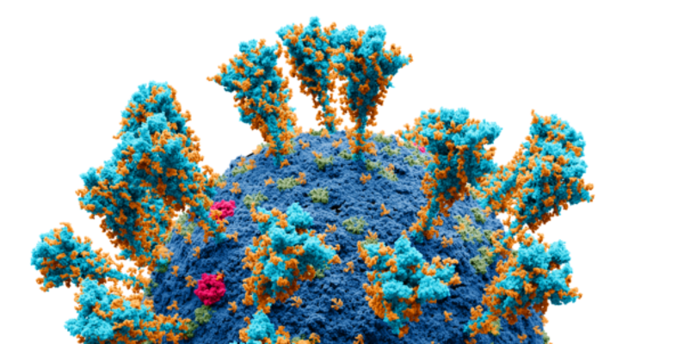
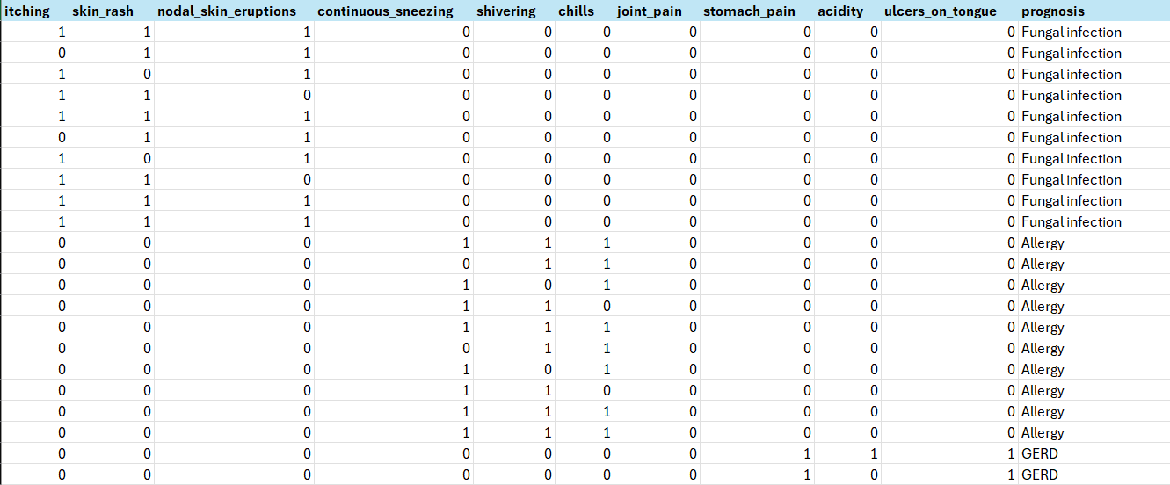
Data Understanding
Dataset Overview:
Source: Kaggle database tracking 132 categorical symptom indicators.
Target Variable: Prognosis with 42 distinct diseases.
Data Composition: (before cleaning)
Training Data: 4,920 records.
Testing Data: Adjusted from 42 to 1,500 records for better evaluation.
After cleaning
Data Source: https://www.kaggle.com/datasets/marslinoedward/disease-prediction-data/data

Slide 5

02
Data

Slide 6
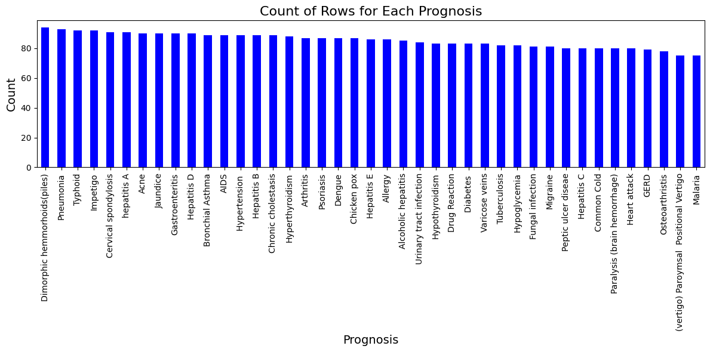
Data Overview and Adjustments
Adjustments
Dataset pre-split into training and testing sets.
Balancing issues: moving 1,500 rows from training to testing. (initially 4,920 rows in training and 42 rows in testing set.
Data Cleaning
Removing missing values, standardizing features (mean = 0, SD = 1)
1
shuffling data to avoid order bias.
correlation matrix
2

Slide 7

03
Model

Slide 8
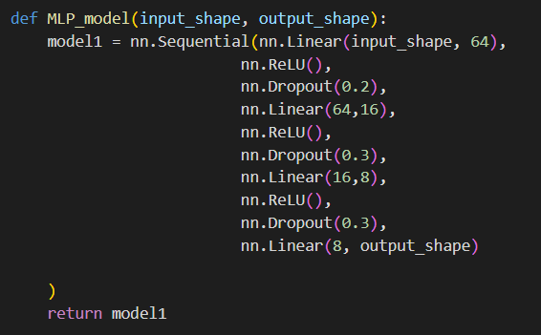
Modeling & Implementation
Hyperparameters
Loss Function: Cross-Entropy Loss (since it is a multi-classification problem
Optimizer: Adam
Learning Rate: 0.0015
Weight Decay: 0.001
Epochs: 200

Slide 9

04
Result

Slide 10
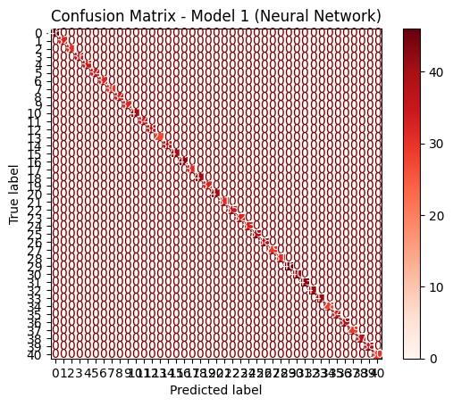
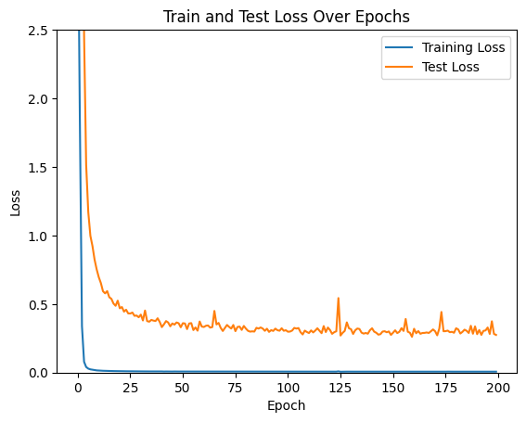
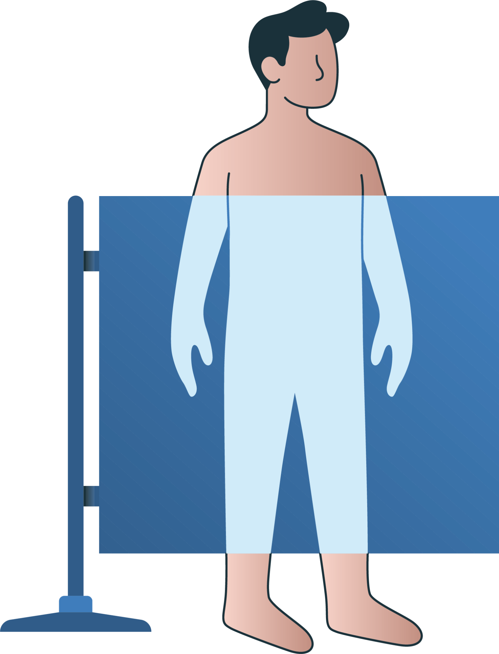

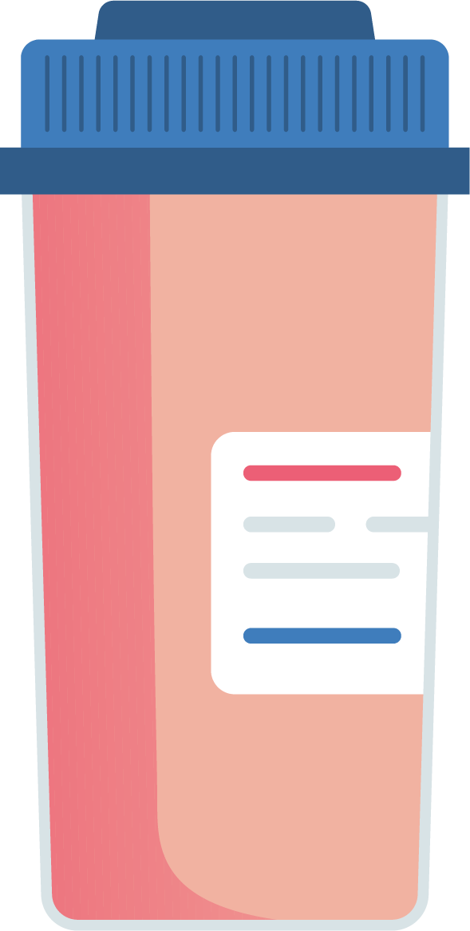
100%
Model Performance

Slide 11

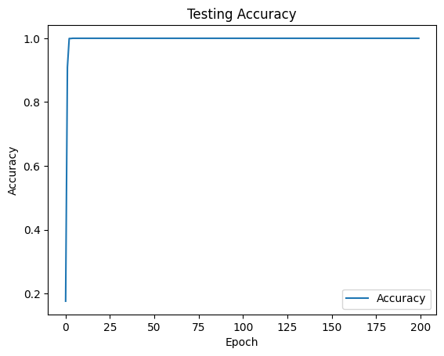
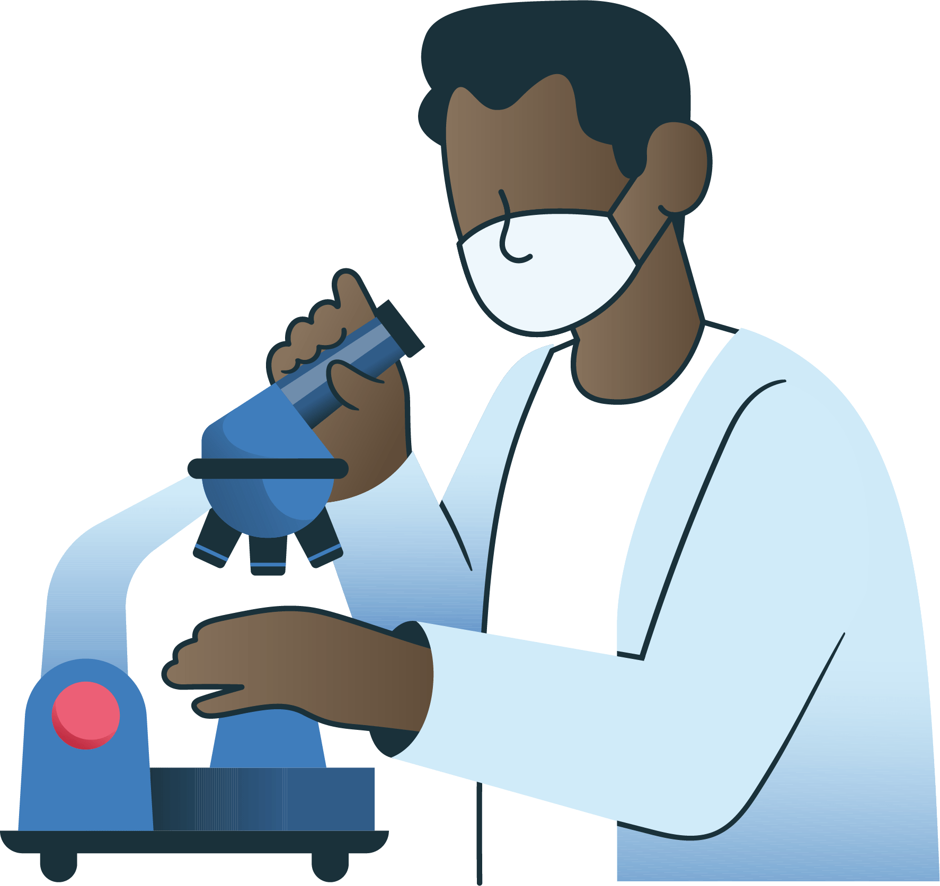
100%
Benchmark Model
(logistic regression)

Slide 12

05
Deployment

Slide 13

Deployment
Medical Practices and Patients Benefit
Can reduce patients misdiagnoses they're sent to proper units of hospitals.
Reduces the time spent waiting for general doctors as hospitals know where to send their patients.
Will have to continually update model to understand new diseases.

Slide 14


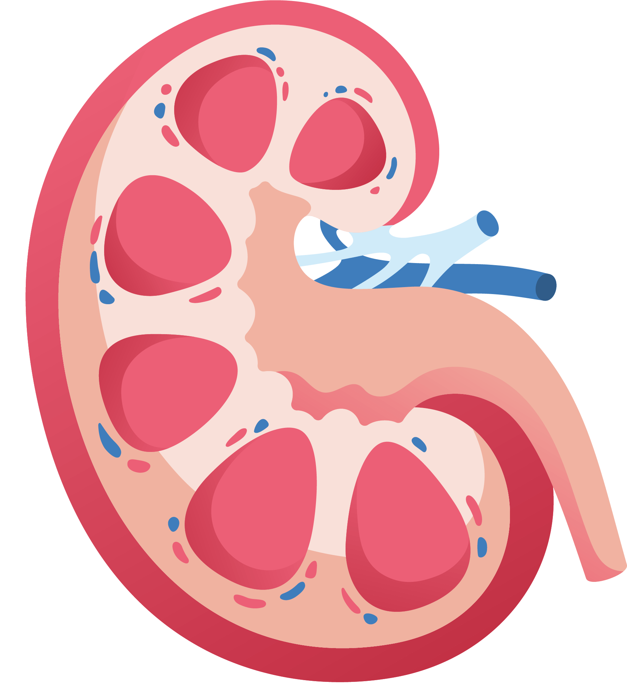
Thank You!

